Slide 1

Content Management in Health Care
Sai Ragini Srimanthula
Aug 16th ,2024

Slide 2
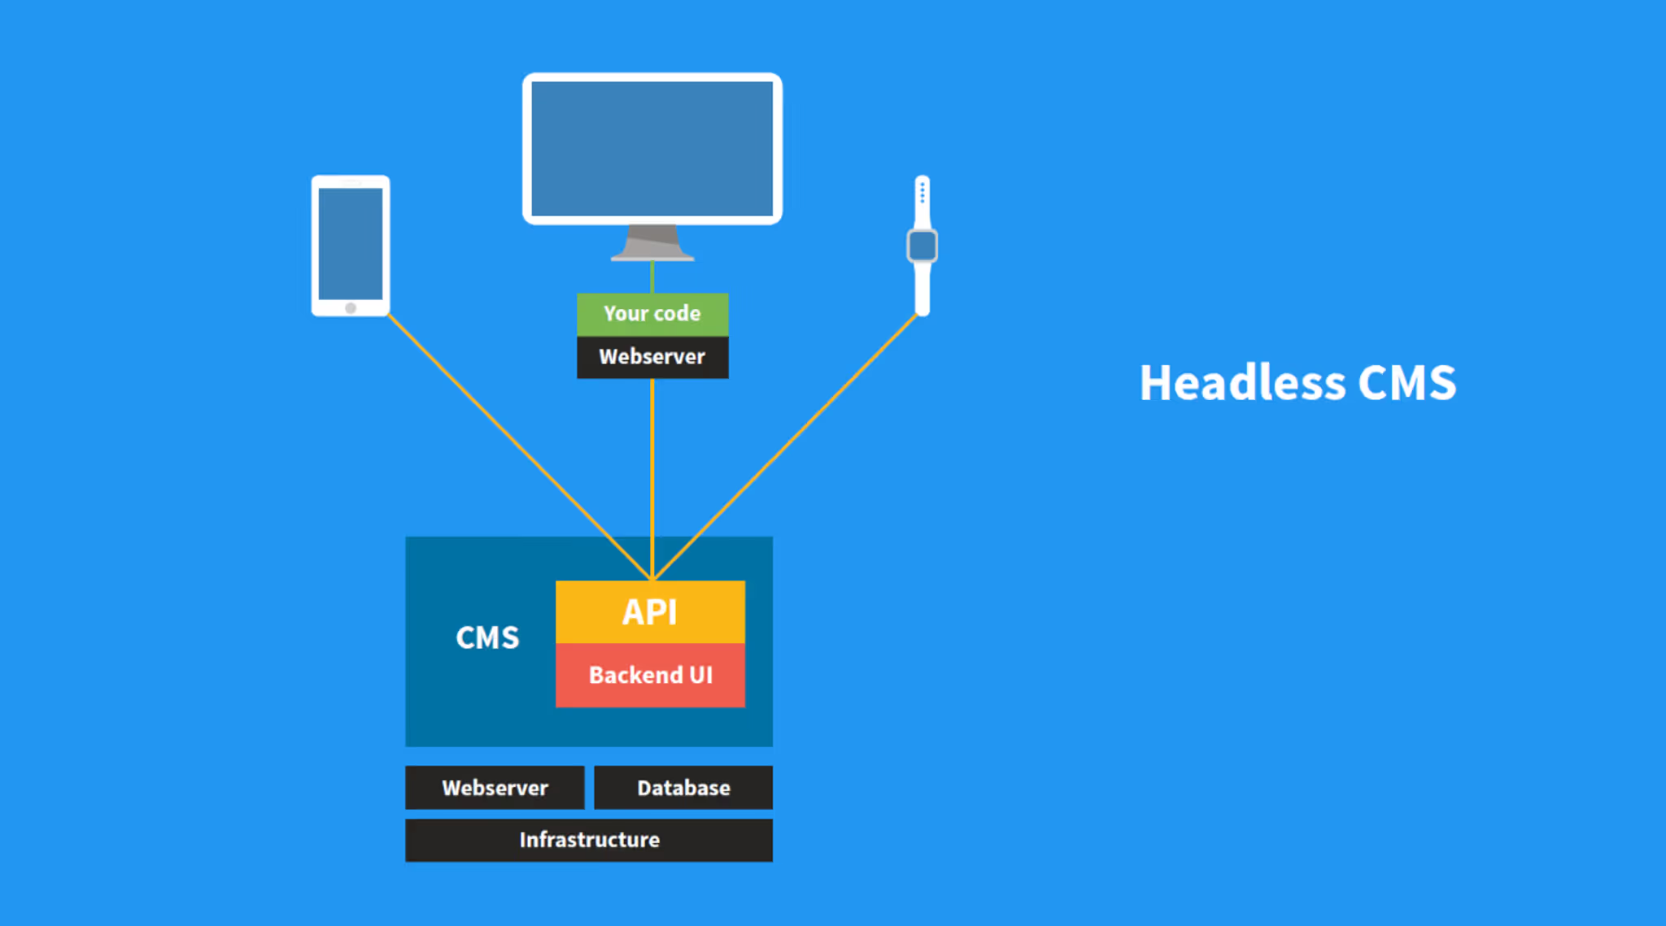
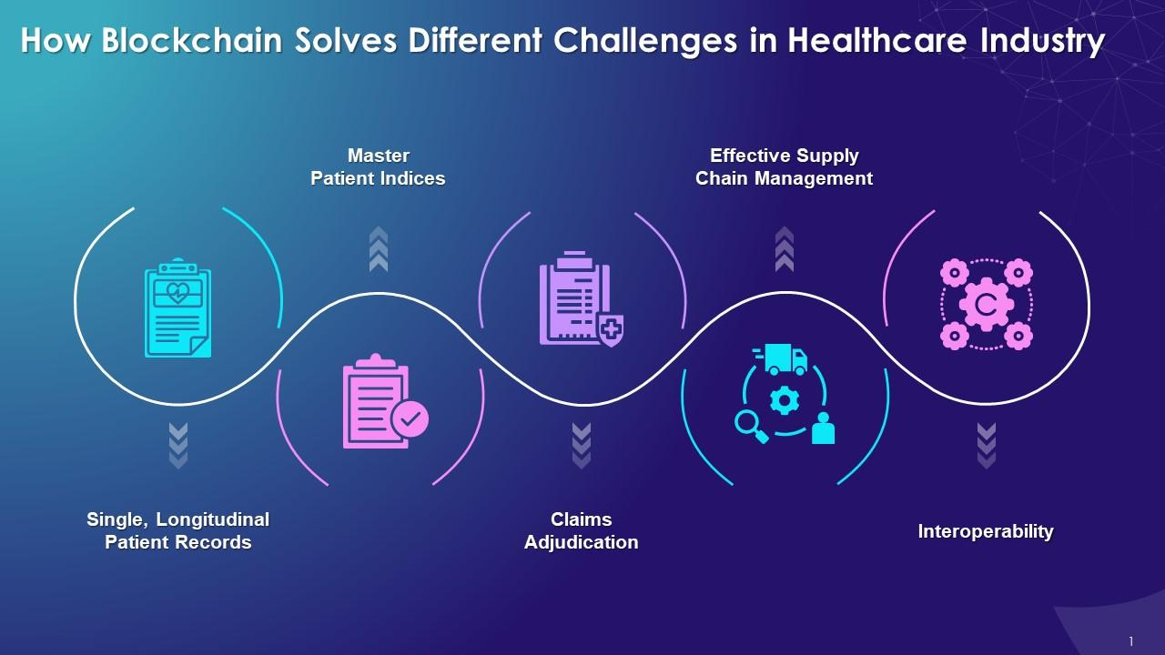
Technology Trends in Healthcare Content Management
Cloud Native Headless CMS
Blockchain
Flexible content management
Simple API integration
Enhanced user experience across multiple channels
Enhanced Security
Secure and Tamper-Proof content
Seamless Access
Enhanced Transparency
Streamlined Compliance

Slide 3
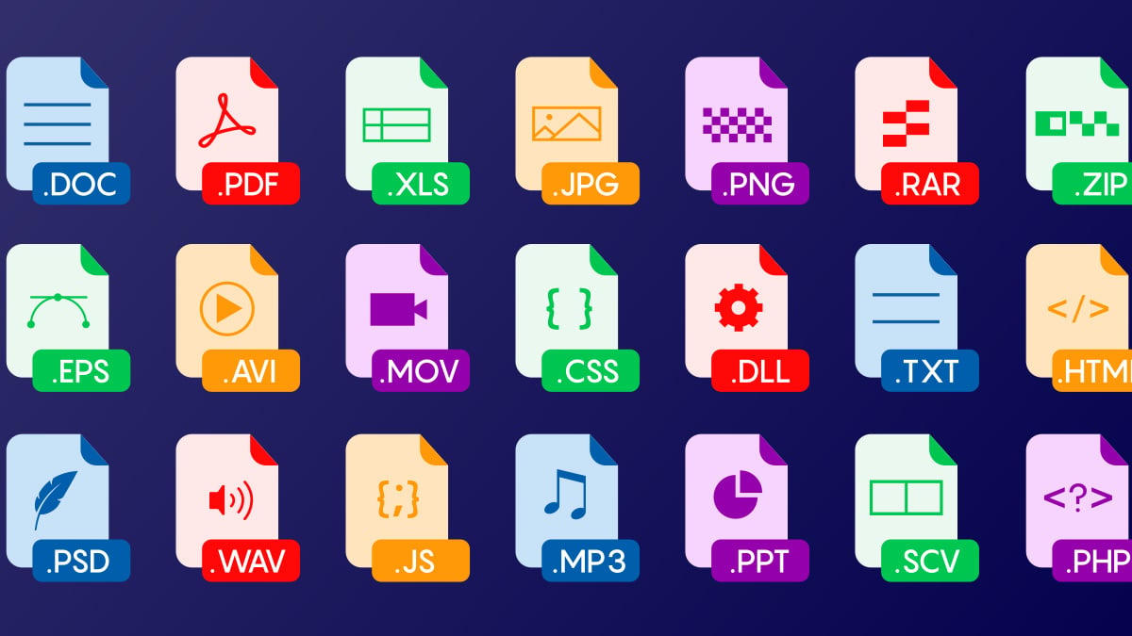
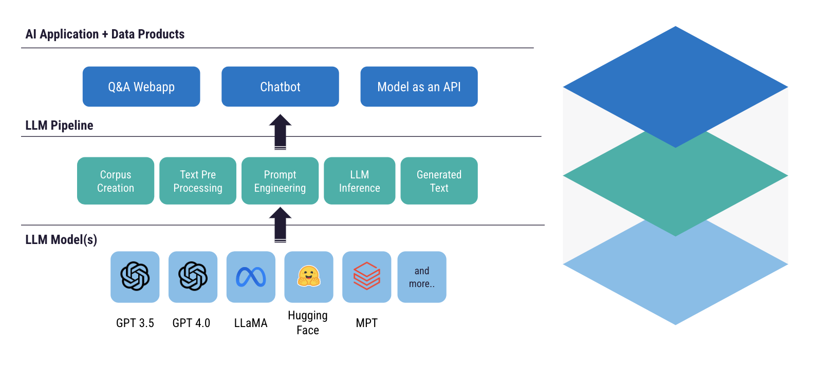
Technology Trends in Healthcare Content Management
Unified Storage
Large Language Models
Integrated file and block storage
Faster data retrieval
Cost Efficiency
High Data Capacity
Advanced text summarization
Key details extraction
Human readable summaries
Personalization and Recommendation
Content Comparison

Slide 4
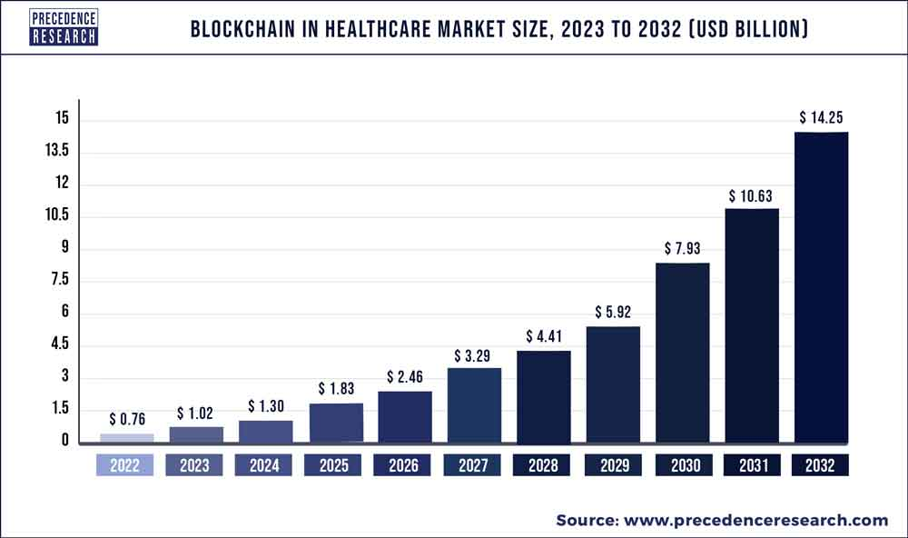
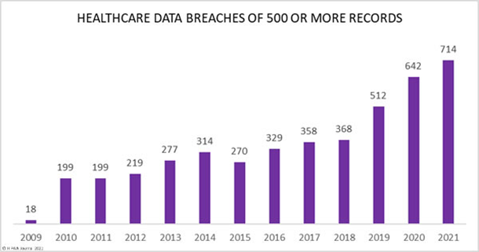
Strategic Investments
Technological advancement in Blockchain →Streamline claims processing with smart automated contracts.
→Provide transparent payment models.
Action : Understand user pain points and market gaps with long term vision for Value Based Care.
Outcome: Differentiation from the competitors, Customer Satisfaction.
Unified Storage of diverse form of medical data
→Consolidated data management.
→Compliments Big Data Analytics
Action : Partner with industry leaders or implement inhouse infrastructure.
Outcome: Enhanced data management, increased product portfolio

Slide 5
Opportunities for Cotiviti
Opportunities | Global Expansion | Product portfolio increment
Strength | Technological capabilities with AI in Fraud Detection, Medical records retrieval and data analytics. | Major market from Insurers and Technology capabilities.
Action | Market Research and Localization | Expand partnership with Insurers, Enter to other areas of Insurance value chain.
Expected Result | Market expansion, Global presence, Revenue growth. | Revenue growth for Cotiviti and Health Care payers, increased client engagement
Threats
Threat of substitution by inhouse tech developed by Health Care Providers and Insurance companies.
High bargaining power of buyer due to competitive market.

Slide 6
Positioning
Strength- AI driven technologies of Fraud detection and medical records retrieval.
Customers- Health Care Payers, Health Care Providers, Governments, Third party administrators, Retailors
Major Competitors – Optum, IQVIA, Oracle health.
Strong presence in USA.

Slide 7

POC – Summarization of Content
Problem Statement: Manually reviewing and summarizing Medical policies, contracts etc is time-consuming and prone to human error, which can lead to inefficiencies and misunderstandings.
Overview : Medical Report Summarizer is a tool designed to streamline the process of extracting key information from medical documents. Built using FastAPI and NLP technique, this Proof of Concept demonstrates how technology can enhance the efficiency of handling medical reports.
Tech Stack :
Frontend – HTML Backend – FASTAPI, uvicorn File Handling – PyPDF2, python-docx NLP – Transformers by Hugging Face Data serialization – JSON

Slide 8
Technical flow
User Interface FAST API Server JSON response User Interface (HTML Page) HTTP request (File Handling) Hugging Face Transformer (Output File) Http response (Display Summary) (File Upload) (Text Summarization) (Summary)
Use Cases
Time efficient review for physicians to review previous medical records.
Convert complex and lengthy medical records, Health plans or contracts to easily readable formats for everyone.
Supporting diagnostic decisions.
Integration to other tools like Comparison of Content changes, Recommendations on diagnostic decisions etc..

Slide 9
Conclusion : This PoC demonstrates a summarization tool that can be integrated into various AI healthcare products to enhance efficiency and decision-making across applications.
Thank you !

